Slide 1
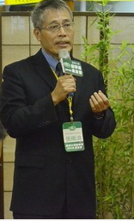
The updates and trends of cell therapy against malignancy
Special Lecture
Dr. Alang Chang(張順浪研發長)
Dean of Research and Development, Medigen Biotechnology Corp.
基亞生物科技股份有限公司
The outlines of tentative talk will include the followings.
1. Introduction of Taiwan 特管辦法 for cell therapy becoming effective in
September, 2018.
2. The impact of 特管辦法
3. An introduction on immune cells used for cancer therapy, including CAR-T and
CAR-NK cells.
4. Tumor microenvironment
5. A proposal for an comprehensive therapy against malignacy
Time:
Thursday, April 18, 2019, 1:30-3:30 PM
Location:
Room B201, Tzu Chi University (慈濟大學B201階梯教室)
Host:
Prof. Rong- Kung Tsai/ Institute of Medical Sciences,
Tzu Chi University (蔡榮坤教授/慈濟大學醫學科學研究所)
Open to the public – all are welcome!
醫學科學研究所
Institute of Medical Sciences
TEL: (03)8565301 Ext.2011

